Slide 1
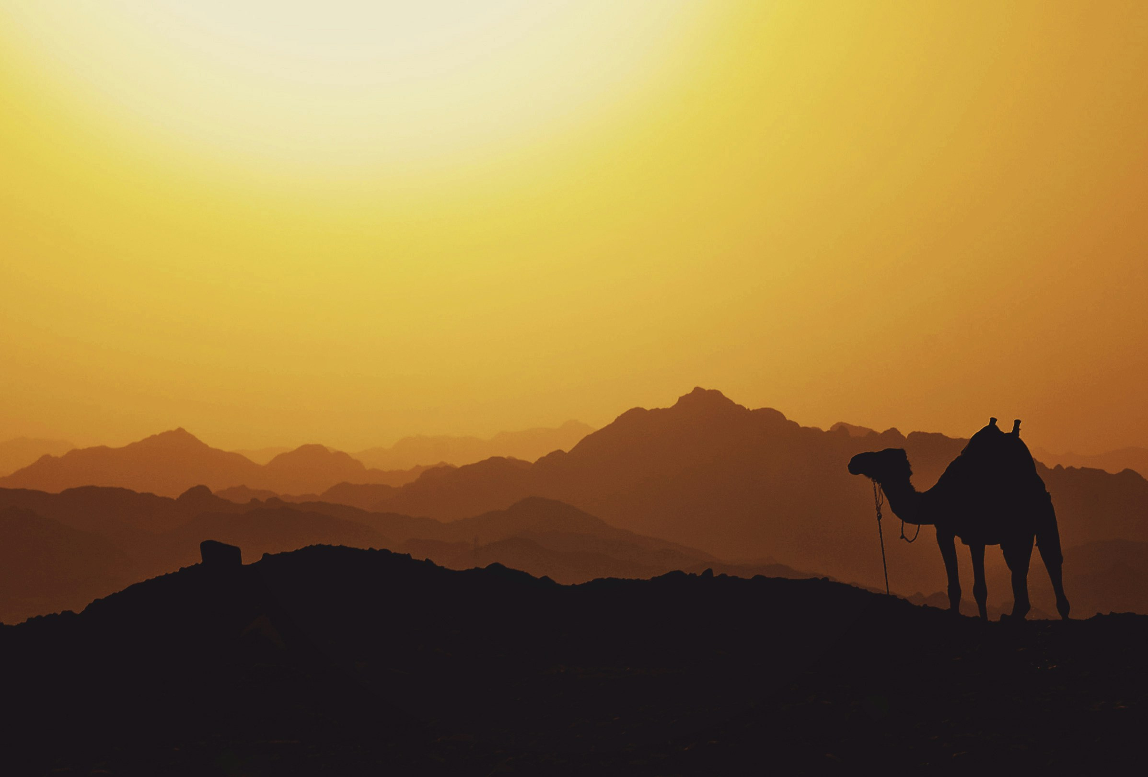
Travel blog
EGYPT

Slide 2

Team
Seif Eldin shady
Saif Hesham
Belal Gadelmoula
Kareem Bakr
omar_abdelazime
Roqaya Ashraf

Slide 3
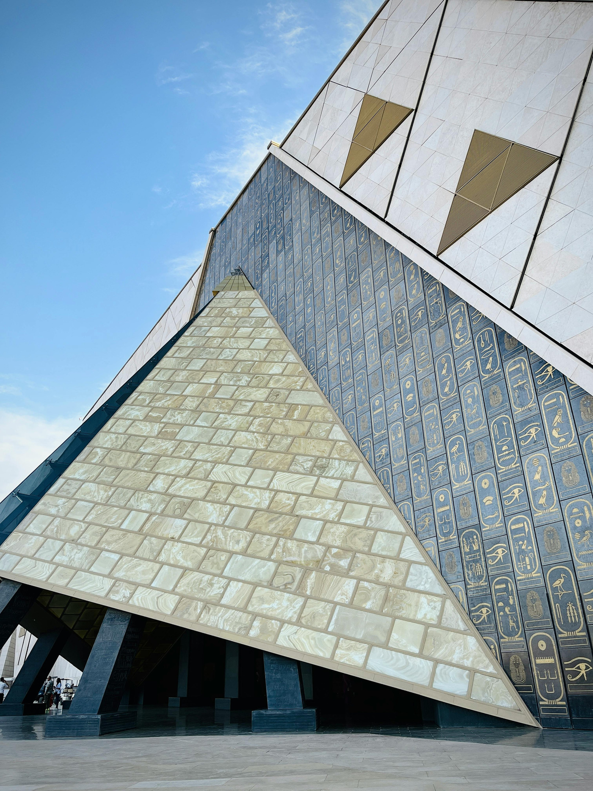
Egypt
Brief introduction to Egypt's rich history, culture, and breathtaking landscapes.
Aim of the blog: To share authentic travel experiences, tips, and guides for exploring Egypt.

Slide 4
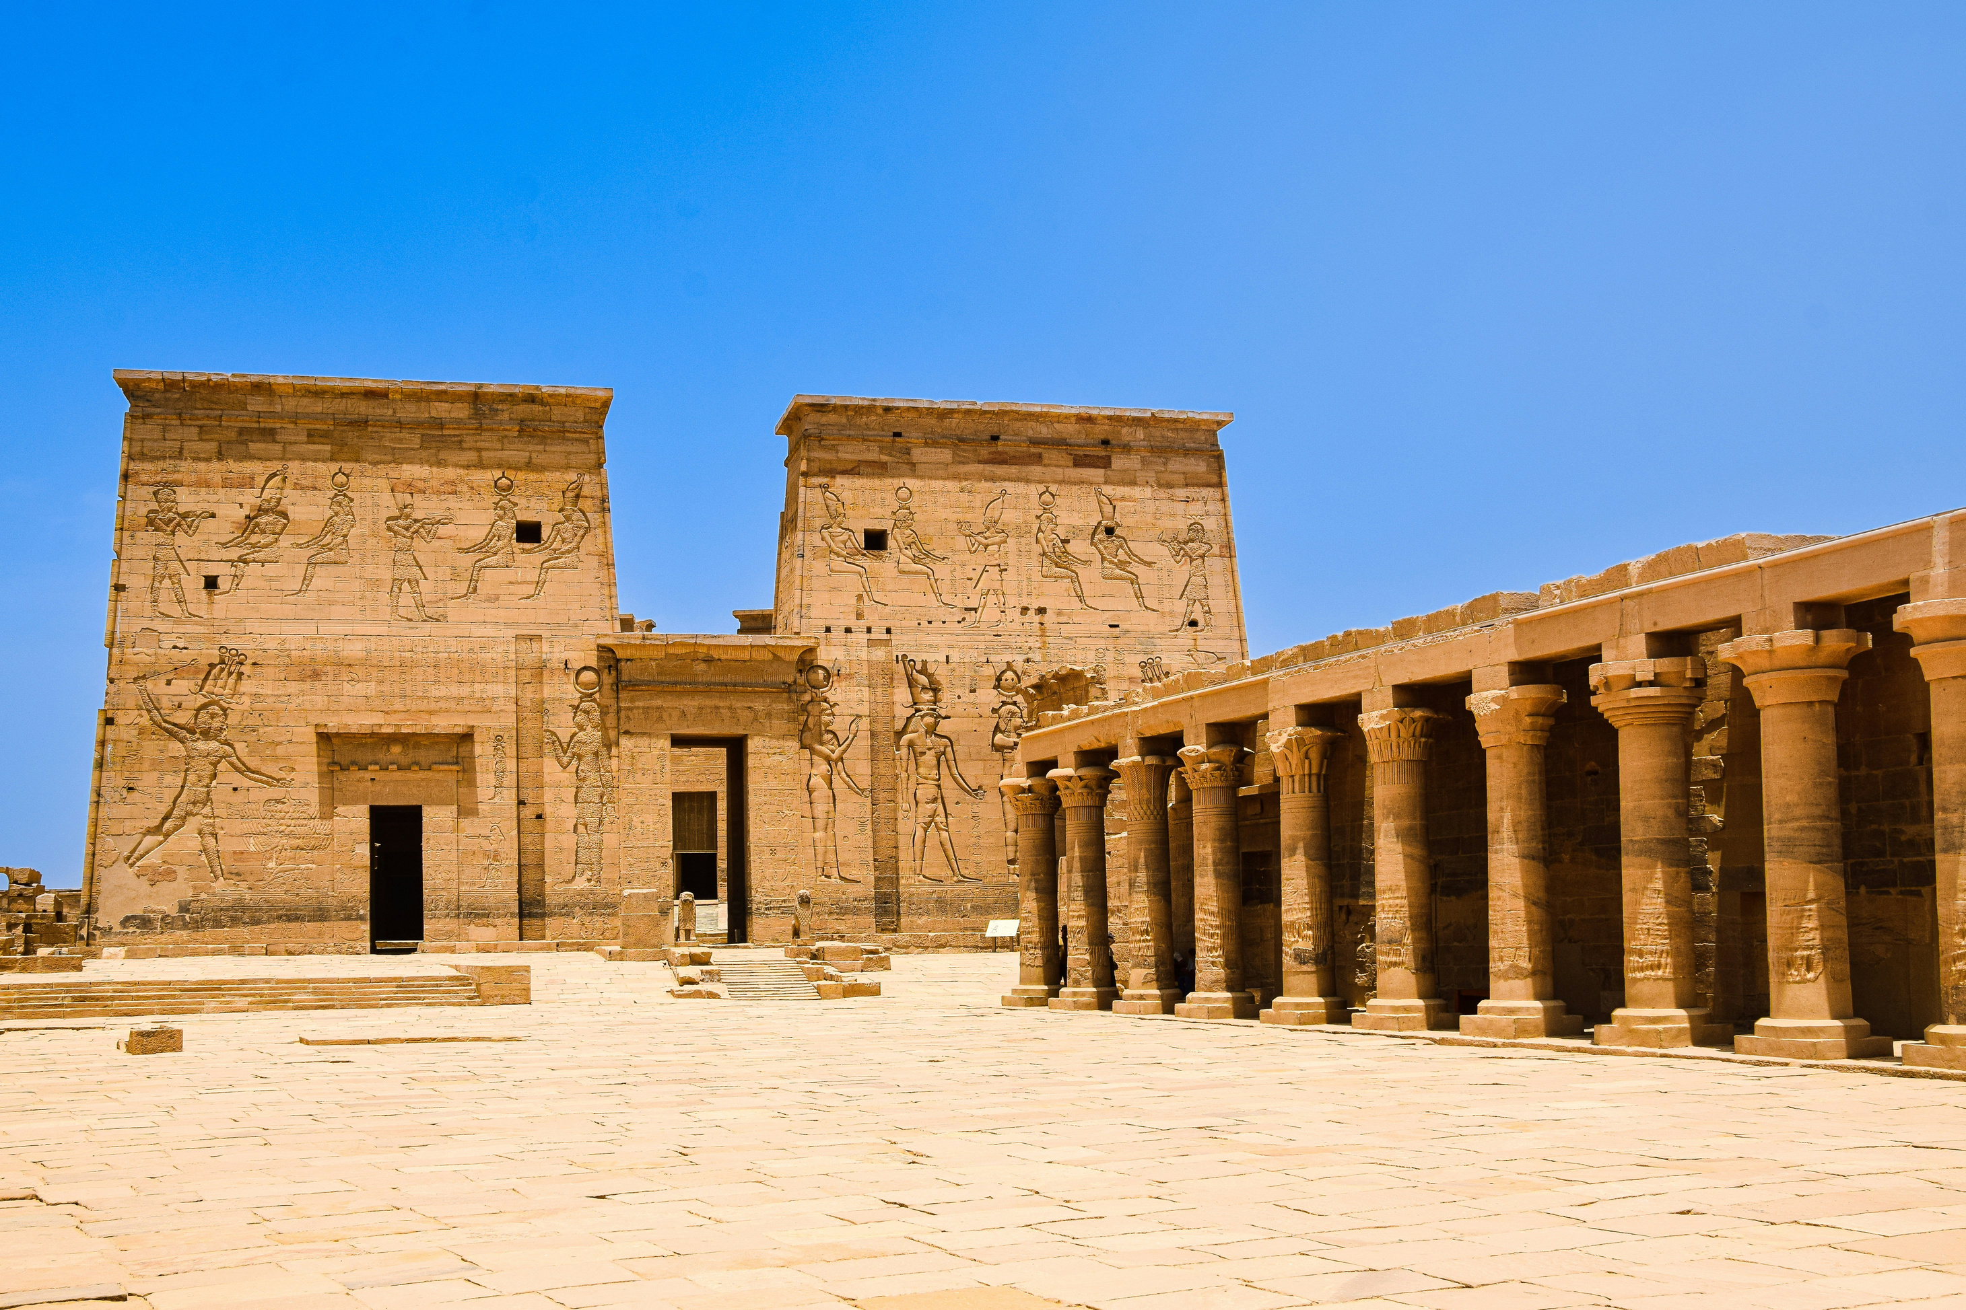
What is Egypt Travel Blog?

Slide 5
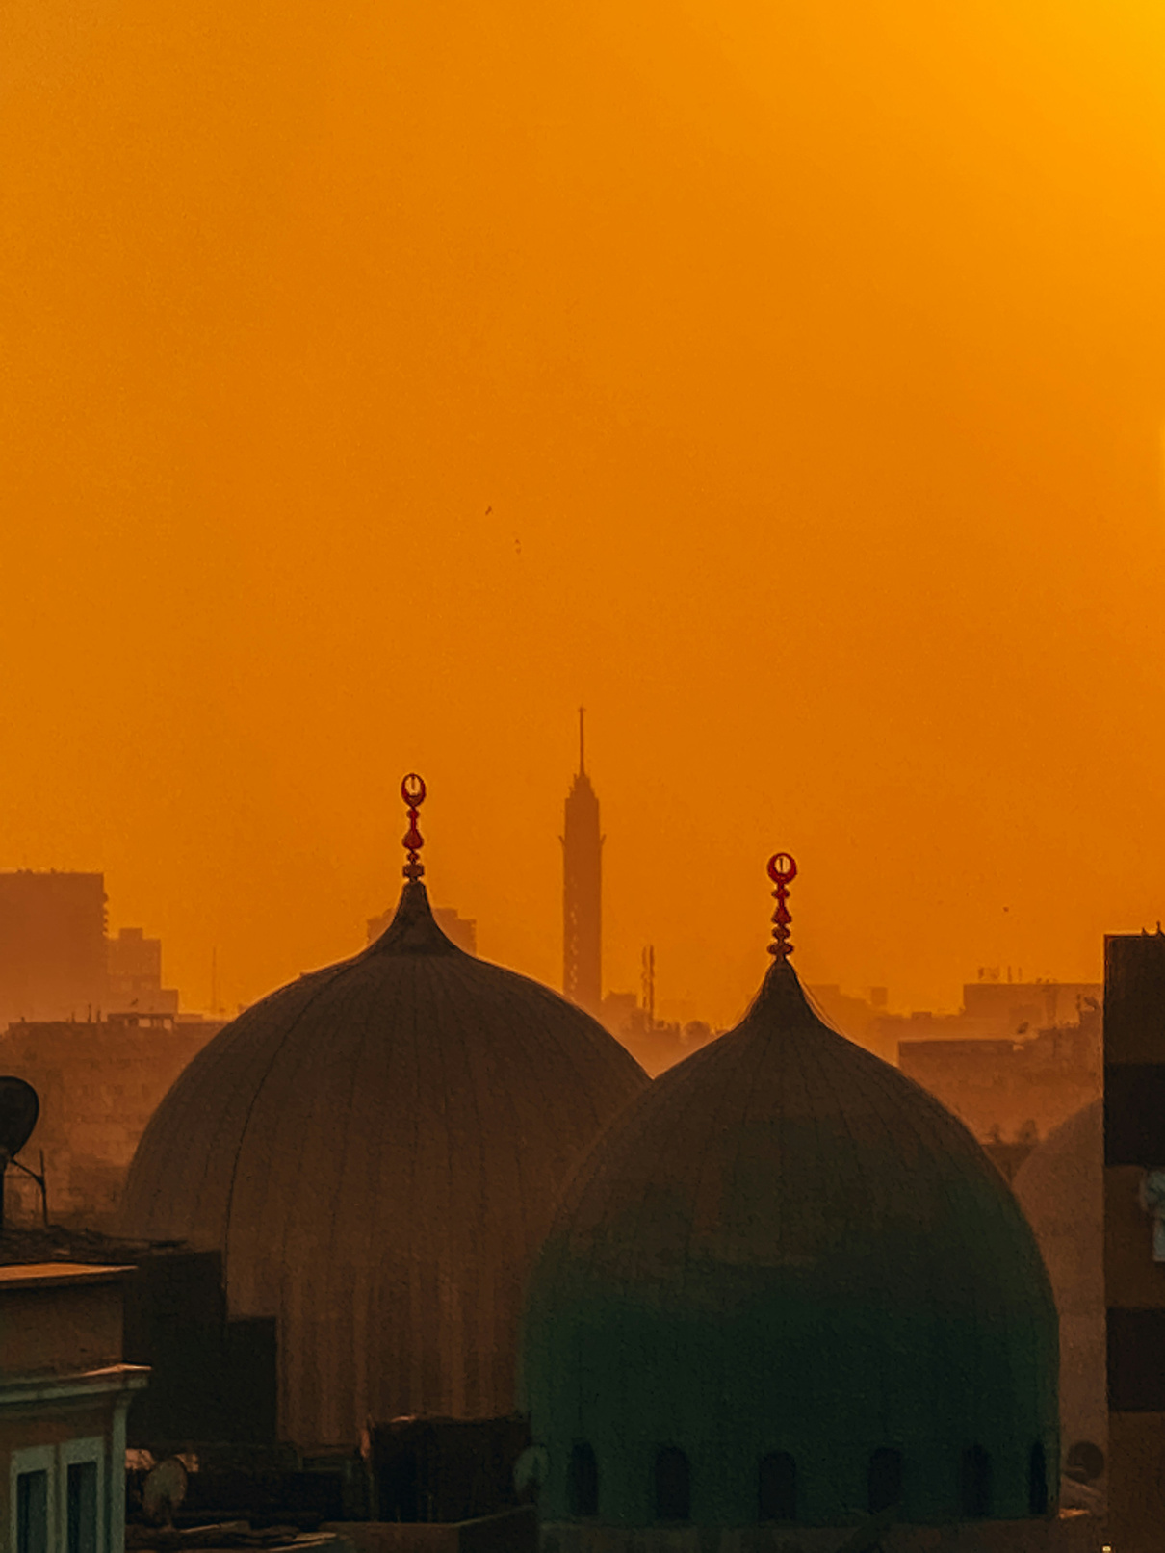
EGYPT
A platform where travelers can read and share personal experiences of exploring Egypt.

Slide 6
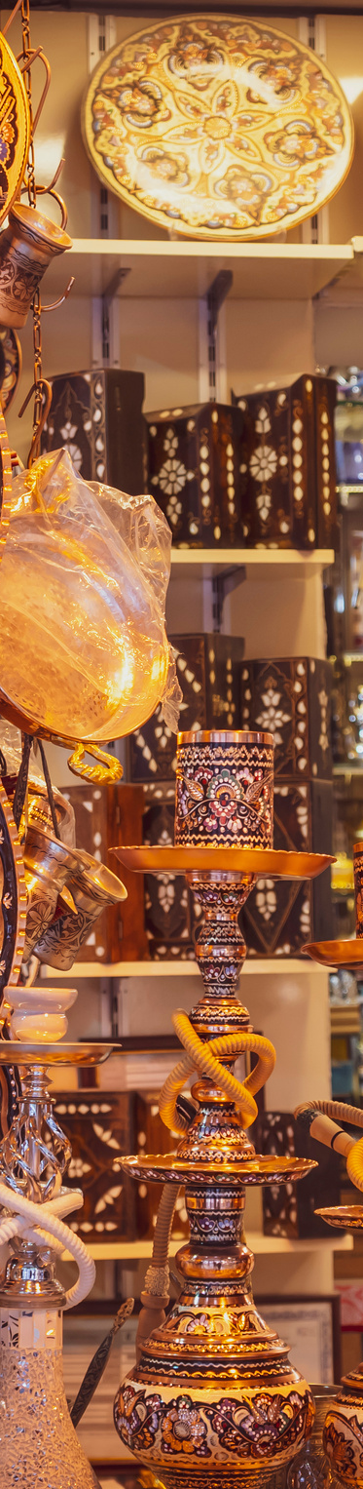
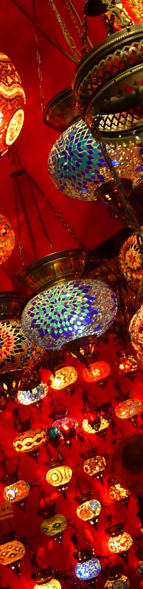
EGYPT
TARGET AUDIENCE
Who is This Blog For?
Travelers looking for Egyptian experiences.
History buffs interested in Egypt’s ancient civilization.

Slide 7

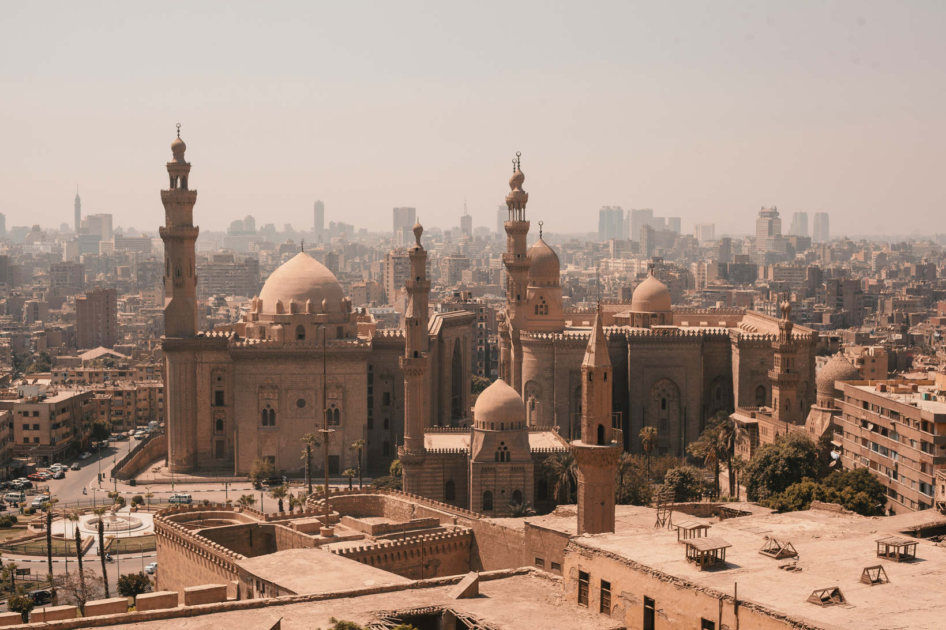
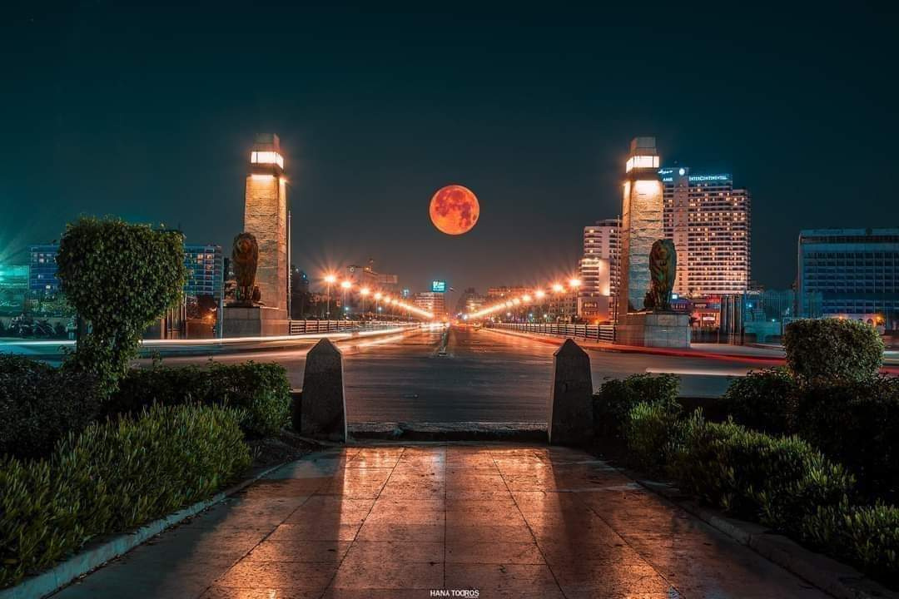
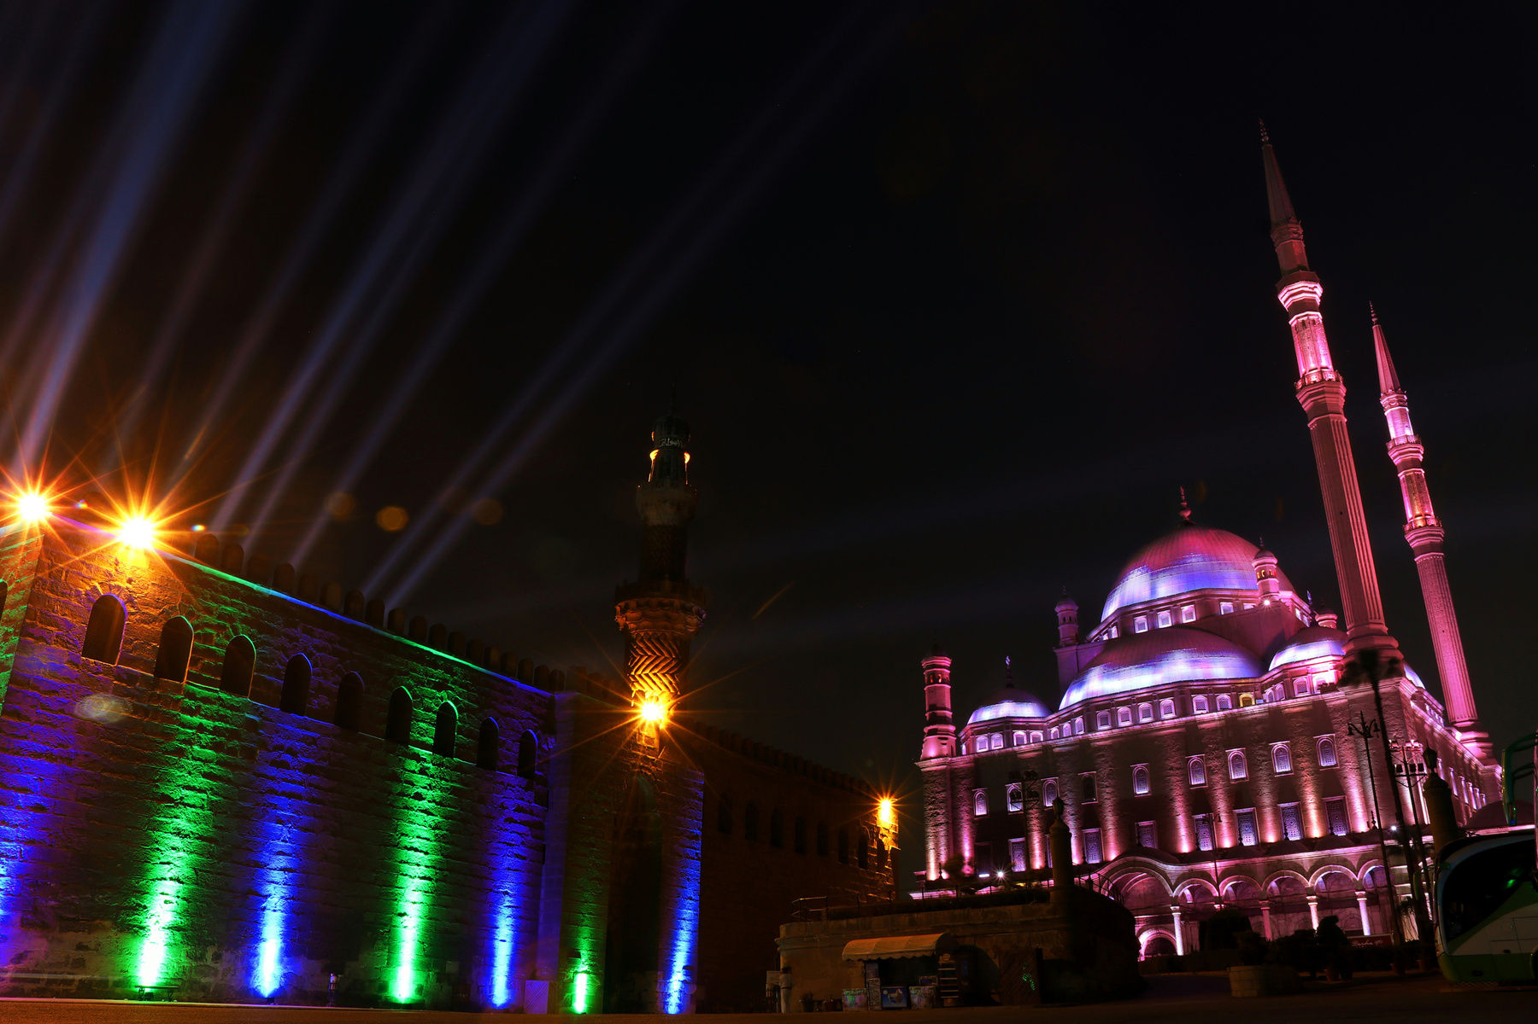
Egypt

Slide 8
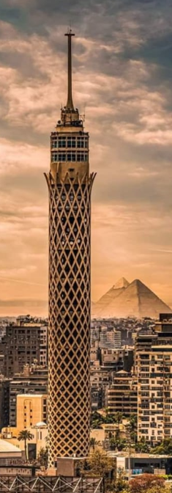

KEY FEATURES OF EGYPT TRAVEL BLOG
Blog Posts: name of the city , summary about it
User Contributions: Registered users can publish their own travel stories and photos.

Slide 9
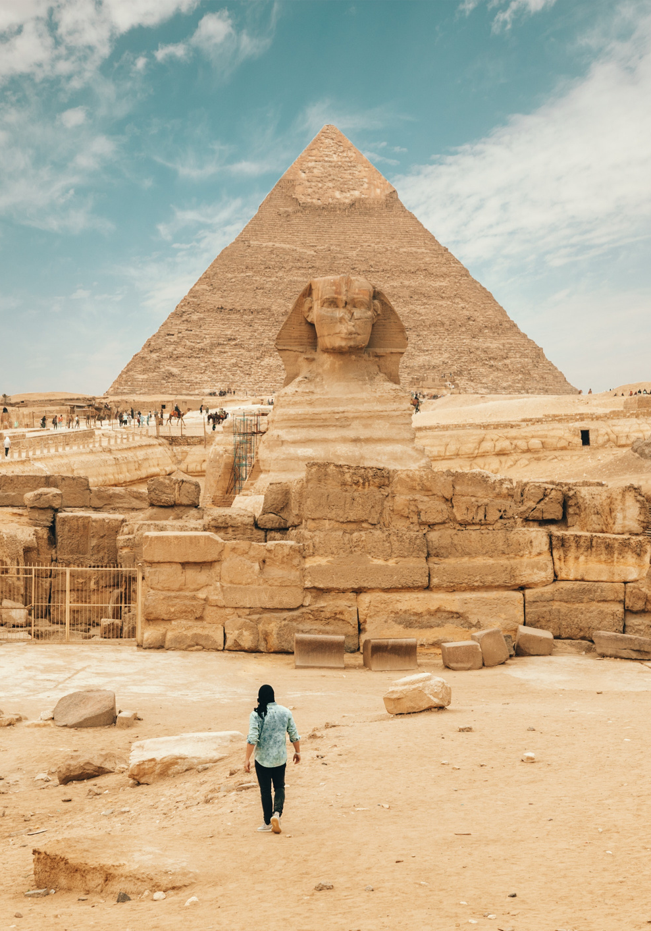
BLOG CATEGORIES
Historical Landmarks: focused on the pyramids, temples, and museums.
Adventure Travel: Desert safaris, diving in the Red Sea, and hiking in Sinai.

Slide 10
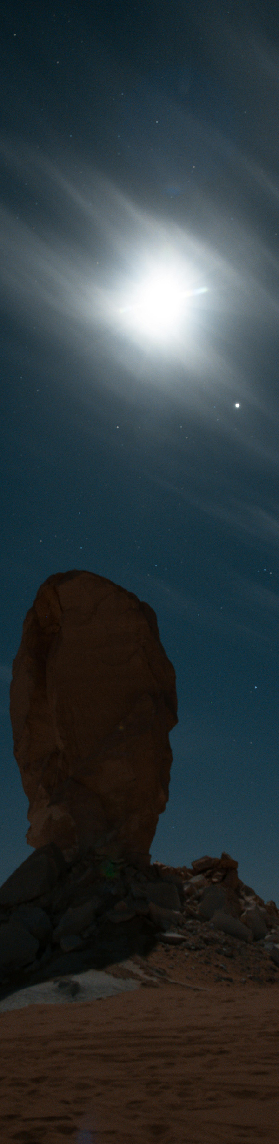
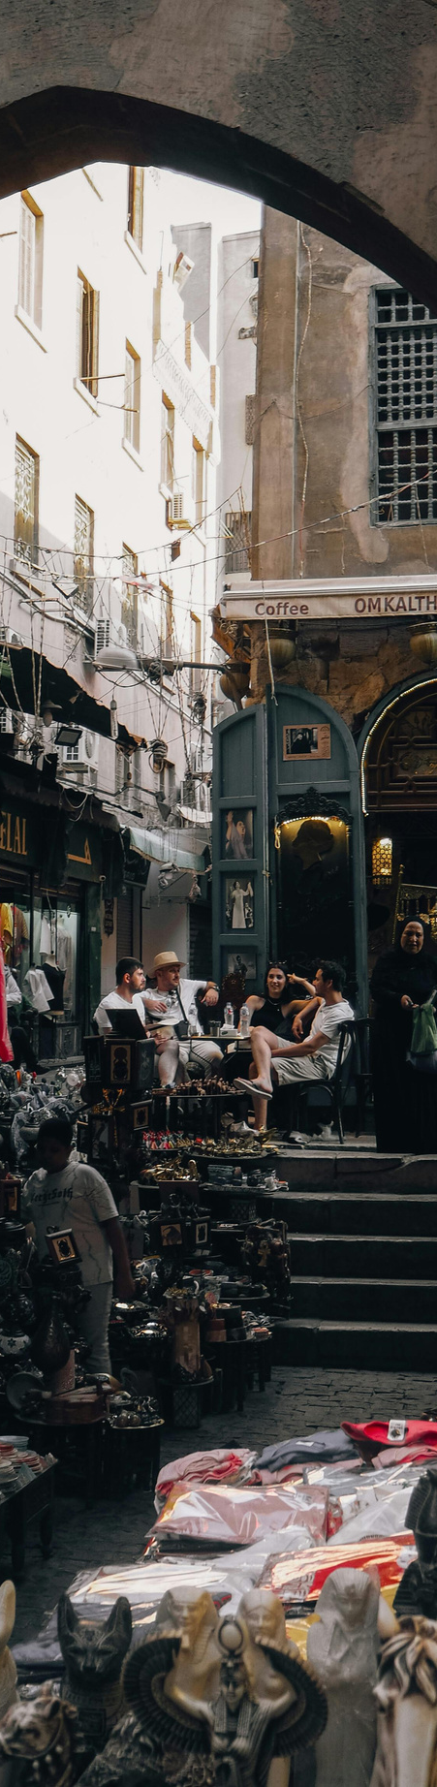
DASHBOARD
User can see his profile and Travels List
User see how many blogs you add
User see when you add the blog
Top Search City

Slide 11
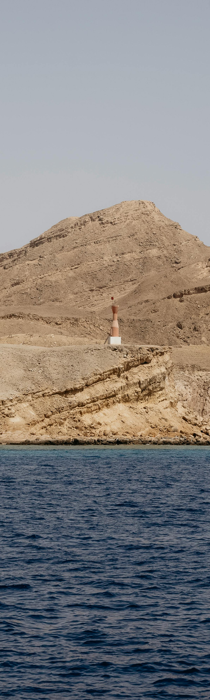
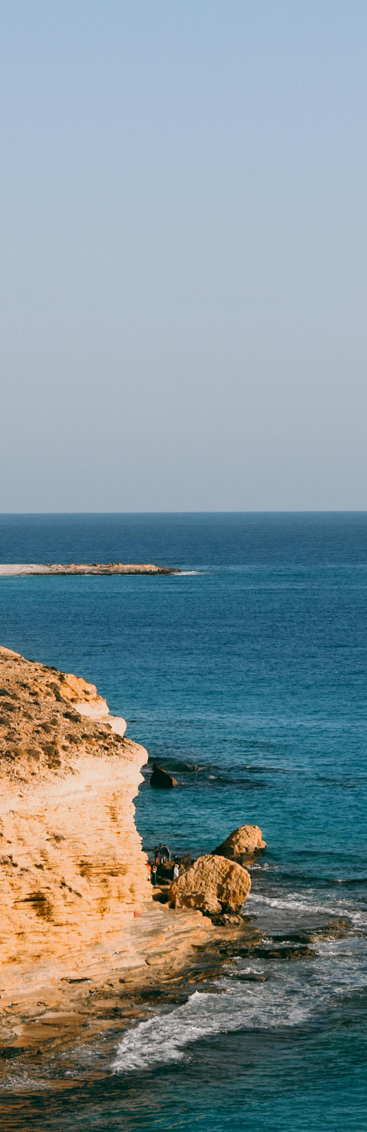
USER EXPERIENCE
Responsive design that works on all devices (desktop, tablet, mobile).
Easy-to-use navigation and a search bar to quickly find relevant blog posts.
Clean, minimalist design that highlights the beauty of Egypt through high-quality images.

Slide 12
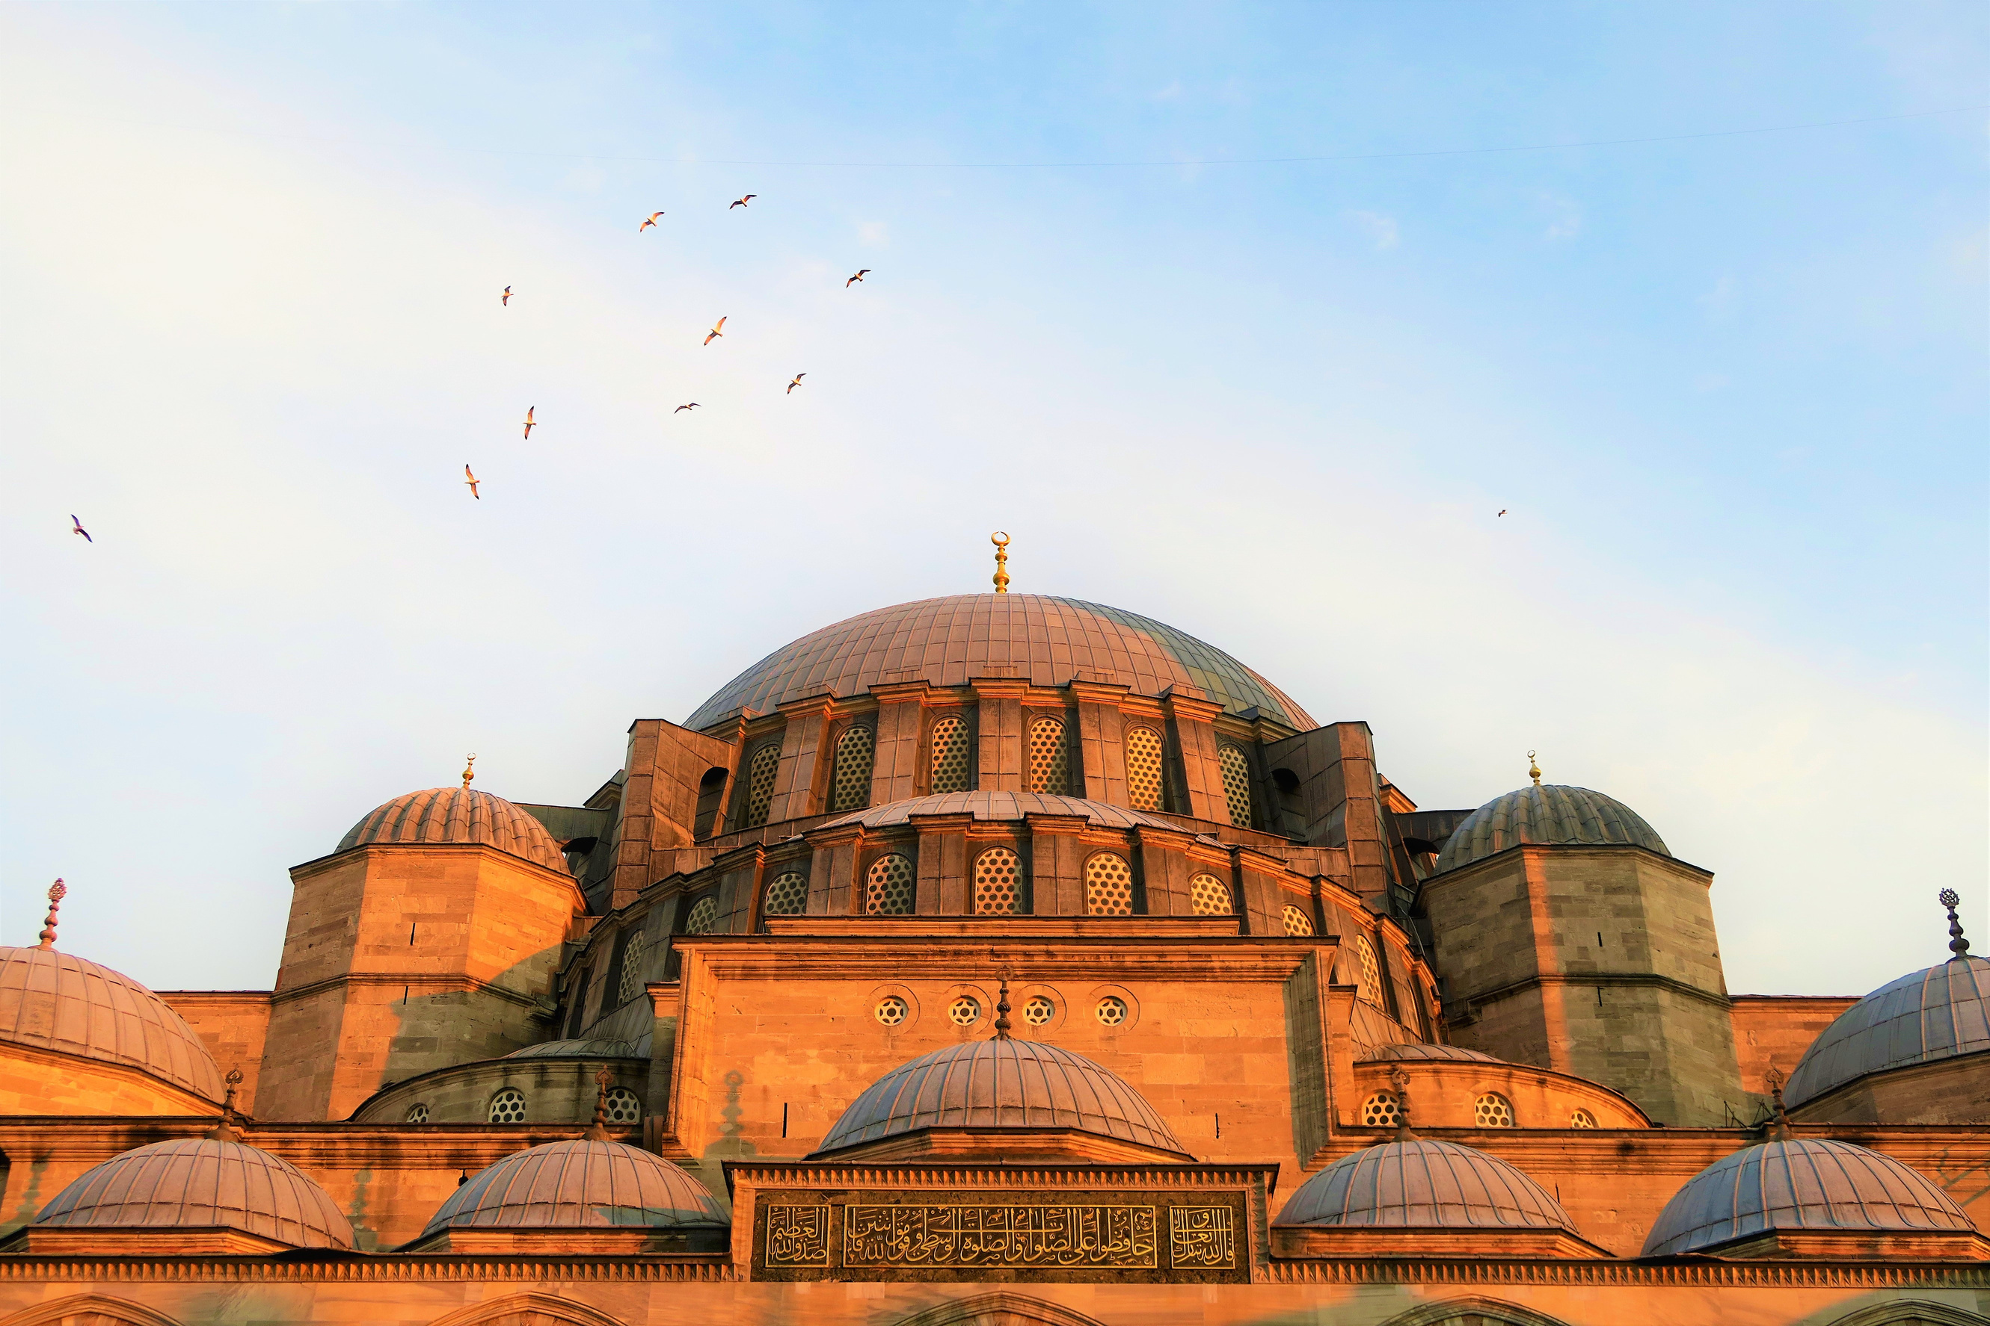
Thanks
Speacial thanks for Eng:Mohamed khairy

